Slide 1
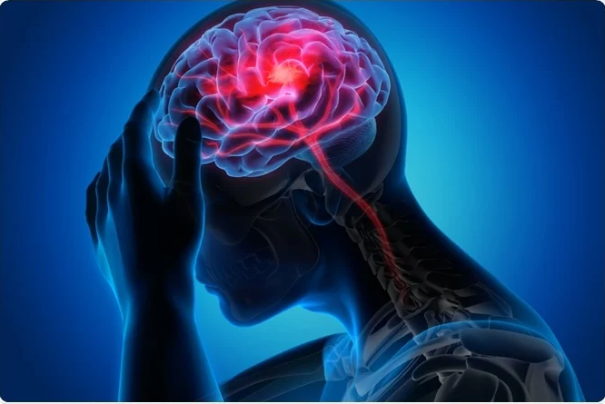
TRAUMATIC BRAIN INJURY
PRESENTED BY ;
RUTH MAINA
PATRICIA KANGAI
BONIFACE KAMARA
DATE : 23/10/2024

Slide 2
OVERVIEW
This project provides an in-depth analysis of Traumatic Brain Injury (TBI), focusing on key dimensions such as military involvement, age demographics, and temporal trends over the years. Using this dataset, the aim is to uncover significant patterns and correlations within these factors, enabling a better understanding of how TBI incidents differ across age groups and within military personnel. By identifying high-risk groups and observing trends over time, the analysis can help guide effective prevention strategies and targeted treatment for those most vulnerable to TBI.

Slide 3
MAIN OBJECTIVE:
Not just to analyze data but to derive and explore actionable patterns in Traumatic Brain Injury (TBI) incidents across three dimensions: military, age groups, and the years when injuries occurred.
Aim to gain insights on how TBI cases vary and identify high-risk groups, to help us inform prevention and treatment strategies.
IMPORTANCE
It is crucial to improve public health policies,.

Slide 4
KEY CONTRIBUTIONS
Data Collection & Preparation:
My team was responsible for gathering, cleaning, and preparing the dataset on TBI incidents, ensuring its accuracy and relevance for analysis.
Data Analysis:
We performed in-depth analysis using SQL and Power BI, focusing on the trends related to tbi_age, tbi_military & tbi_year occurrences.
Visualization & Insights:
We created 3 visual dashboards to highlight the key findings, such as the rise in emergency treatments and hospitalizations, and came up with comparisons across different categories for tbi_age, tbi_age groups and tbi_military.
Notes:
Our team focused on the data collection and preparation for TBI incidents, ensuring the dataset's accuracy and relevance. We conducted in-depth analysis using SQL and Power BI to explore trends related to age, military involvement, and the years of occurrence for TBI cases. To present our findings effectively, we developed three visual dashboards that highlighted key insights, including the increase in emergency treatments and hospitalizations, as well as comparisons across various age groups and military branches.

Slide 5
METHODOLOGY

Slide 6
DATA COLLECTION AND PREPARATION
Data Source
For this project, we sourced our dataset from TidyTuesday on GitHub, known for offering a variety of open datasets. This particular dataset focuses on Traumatic Brain Injury (TBI) incidents, providing valuable insights into various contributing factors such as age groups, military, and the years in which these injuries occurred.
DATA CLEANING PROCESSES: Cleaning the data was a crucial step in our analysis, and we conducted this process using Power BI. Our primary goal was to ensure that the dataset was accurate and ready for meaningful analysis. My team took some key steps during the cleaning process:
Removal of N/A Values: We identified and removed any rows with missing (N/A) values. This was essential, as such entries can distort analysis results and lead to misleading insights.
Inconsistency: We examined the dataset for inconsistencies, such as varying formats for categorical variables (e.g., different spellings for the same location). This step helped ensure that all data points were uniformly represented, making our analysis more realistic.
Data Type Corrections: Some data points were mislabeled, so we adjusted the data types where necessary. For example, we ensured that numerical data was classified as whole number or decimals rather than as text, to allow for accurate calculations and visualizations.

Slide 7
Data Presentation
Once the cleaning process was complete, we prepared the dataset for analysis. This involved several steps, including:
Filtering Relevant Data: We focused on filtering the dataset to include only the most relevant information about TBI incidents. This helped streamline our analysis and ensured we were looking at data that directly impacted our research objectives.
Transformation: We created new variables where necessary to enhance our analysis. For example, using data by year to observe trends over time more clearly.
Visual Representation of Relationships: To illustrate the relationships between the three data entities, we created Entity-Relationship (ER) DIagrams. These diagrams helped clarify how different datasets interconnect and relate, allowing for a better understanding of the data structure. Additionally, we developed a database (DB) diagram to provide a comprehensive overview of the overall database architecture.

Slide 8
Tools Used:
To facilitate our work, we utilized using
SQL for data extraction and manipulation. This allowed us to query the dataset efficiently and prepare it for analysis and enabling in-depth analysis of TBI incidents.
Power BI played a vital role in creating visualizations, enabling us to develop three separate dashboards, each focused on one of the key datasets, employing various visual tools which are;
Slicers for interactive filtering.
Stacked line charts to show trends for each category.
Horizontal bar graphs for categorical comparisons for the TBI incidents.
Donut charts for percentage distributions to highlight factors that contribute to overal TBI cases.
One card for to highlight magnitude of TBI incidents per year.

Slide 9
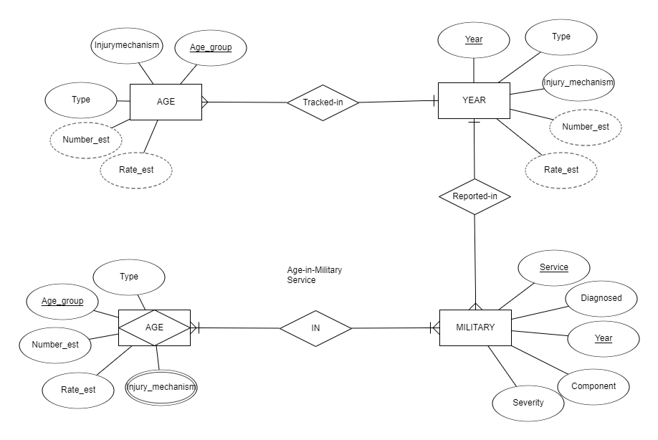
ER DIAGRAM
Notes:
This diagram illustrates the relationship between age groups, military service, and TBI incidents over time, showing how different attributes like injury mechanism, severity, and rate are connected across these entities. It allows for the analysis of how age, military service, and the year of the injury impact TBI occurrences and trends.

Slide 10
RELATIONSHIP
This ERD represents the structure of a database focused on Traumatic Brain Injury (TBI) data. The dataset captures TBI incidents across different age groups, reported over specific years, and includes data about injuries diagnosed within military service. The goal is to understand how TBI trends occur based on age, year, and military involvement.”**
Age table to year table [ many-to-one]
Year Table to Military Table [many -to-one]
Military to Age [many-to-many].
The AGE entity represents the different age groups affected by TBI, with attributes such as the injury mechanism (e.g., falls, motor vehicle accidents), the estimated number of cases (Number_est), and the rate of incidents (Rate_est). The relationship between AGE and YEAR is Tracked-in, showing that TBI cases are tracked over time, which is a one-to-many relationship, meaning that each age group can be tracked over several years, but each year only corresponds to a single age group.

Slide 11
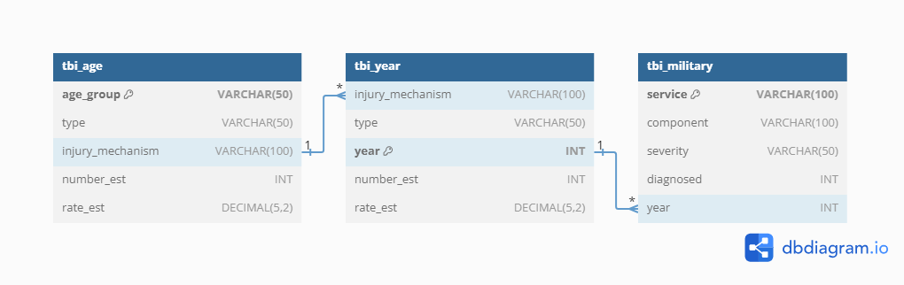
DATABASE STRUCTURE

Slide 12
KEY FINDINGS

Slide 13
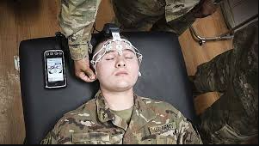
Leading Causes of TBI: The most significant cause of TBI incidents is unintentional falls. However, for individuals aged 15 to 34, motor vehicle crashes are the primary contributors to brain injuries.
Military Branch Comparison: The Air Force reported the least severe cases of TBI compared to other military branches, suggesting effective safety practices that could be adopted more broadly.
Trends Over Time: There has been an exponential increase in TBI incidents over the years, with notable rises in emergency treatments and hospitalizations. Conversely, the death rate from TBI has remained relatively stable during this period.

Slide 14
Demographic Insights: The data highlights that younger adults, particularly those aged 15 to 34, are at a higher risk for TBIs due to specific causes like motor vehicle crashes, emphasizing the need for targeted prevention strategies in this age group.
Healthcare System Impact: The rising trend of TBI cases indicates a growing demand for resources within the healthcare system to manage treatment and prevention effectively.

Slide 15
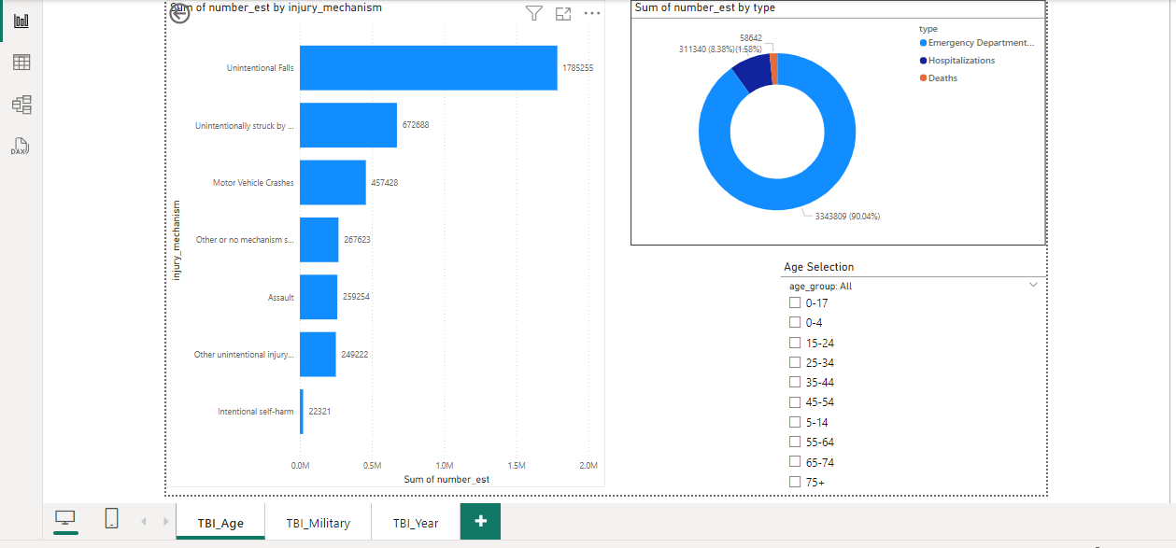
AGE-TBI

Slide 16
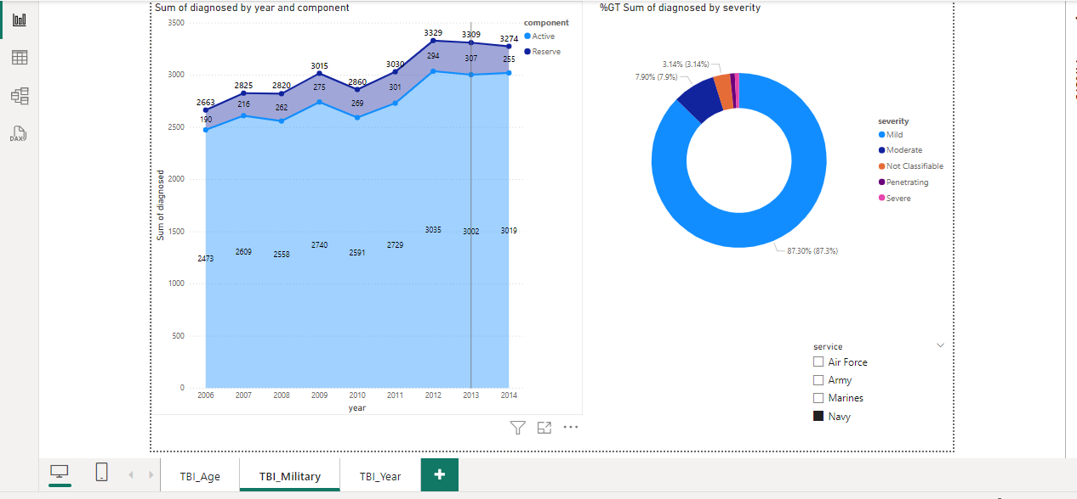
MILITARY-TBI

Slide 17
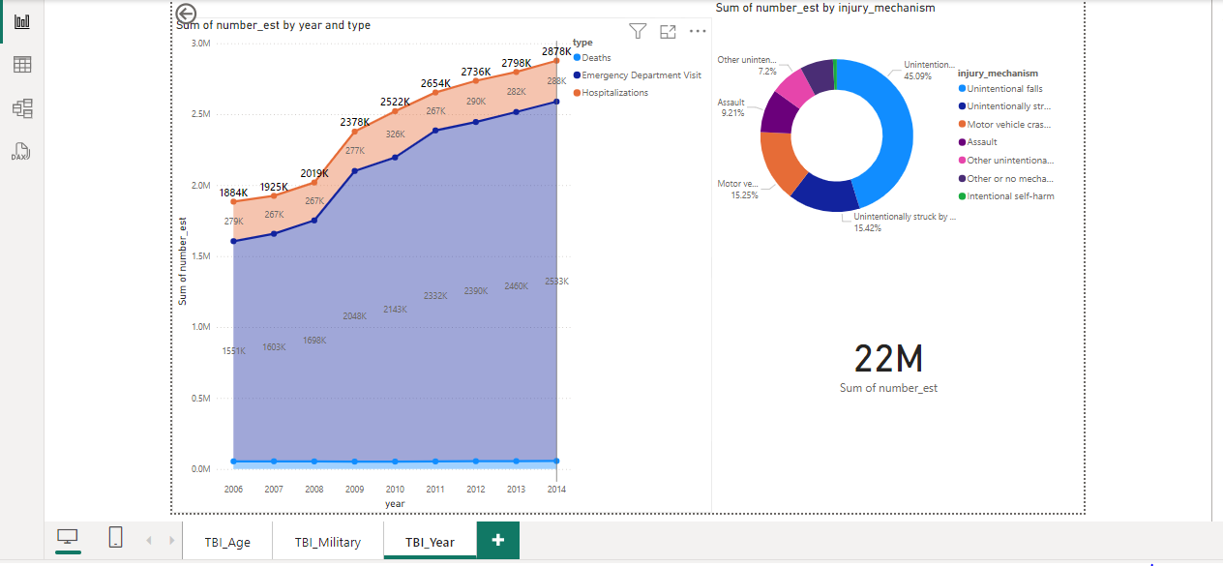
YEARTBI

Slide 18
KEY TAKEAWAY
Public Health and Safety: There’s the need for targeted safety measures, especially for young adults (15-34), who face higher risks from motor vehicle crashes. Unintentional falls, the leading cause of TBI, call for stronger public health campaigns on accident prevention in homes and workplaces.
Military Protocols: The Air Force's lower severity of TBIs suggests that some of their safety measures could be adapted by other military branches to reduce the impact of brain injuries.
Healthcare System Readiness: The high rise in emergency treatments and hospitalizations for TBI points to the need for healthcare systems to allocate more resources and implement preventive strategies to address this growing public health challenge.
Notes:
There is an urgent need for targeted safety measures, particularly for young adults aged 15 to 34, who are at higher risk of TBI from motor vehicle crashes. Since unintentional falls are the leading cause of TBI, stronger public health campaigns focused on accident prevention in both domestic and occupational settings are essential. Additionally, the lower severity of TBIs in the Air Force suggests that their safety protocols could be beneficial for other military branches. Finally, the increase in emergency treatments and hospitalizations for TBI highlights the necessity for healthcare systems to allocate more resources and implement preventive strategies to address this pressing public health issue.

Slide 19
DISCUSSION
In diving into the dataset on Traumatic Brain Injury (TBI), we've uncovered some significant insights that demand our attention. One of the most striking findings is that unintentional falls are the leading cause of TBIs across all demographics. This highlights a pressing need for targeted public health campaigns aimed at accident prevention, especially in homes and workplaces. Vulnerable populations, like children and the elderly, should be a primary focus of these initiatives.
When we look specifically at young adults aged 15 to 34, motor vehicle crashes emerge as the greatest contributors to brain injuries. This underscores the importance of implementing stricter road safety measures and educational programs tailored to this age group. By engaging communities in road safety awareness, we can work towards reducing the incidence of these preventable injuries.

Slide 20
Interestingly, our analysis revealed that the Air Force has the lowest severity of TBIs among military branches. This finding suggests that there are effective safety practices in place that could be beneficial if adopted by other military branches. By sharing and implementing these protocols across the armed forces, we could potentially reduce the overall severity of TBIs among military personnel.
Another key aspect of our analysis is the exponential rise in TBI incidents over the years. Although the death rate has remained steady, the increased number of emergency treatments and hospitalizations indicates that our healthcare systems must be equipped to handle this growing public health challenge. It's essential for healthcare providers to not only allocate resources efficiently but also focus on preventive strategies to address the increasing rates of TBI.
Notes:
This project highlighted key causes and trends in Traumatic Brain Injury (TBI), showing that young adults face higher risks from motor vehicle crashes, while unintentional falls are the leading cause across all groups. The Air Force's lower TBI severity suggests safety protocols that other branches could adopt. The rise in hospitalizations calls for better healthcare preparedness and preventive measures. Overall, this analysis shows the importance of using data to drive informed decisions in public health, military safety, and healthcare planning.

Slide 21
RECOMMENDATION
From the above findings we advise: -That the military, in general, should take whatever precautionary measures the Air Force has taken to prevent situations or accidents that may lead to brain injuries. -For caution to be taken, especially with children and the elderly, to prevent unintentional falls. -Pedestrians and motorists to be careful on the roads. The authorities should also be proactive in ensuring the roads are safe and traffic rules are followed to the latter. -In case of an accident, kindly seek medical attention

Slide 22
CONCLUSION
This project has provided valuable insights into the patterns and causes of Traumatic Brain Injury (TBI), particularly among military personnel and different age groups. The findings point to the need for targeted safety measures, especially for young adults at high risk from motor vehicle crashes and the general population affected by unintentional falls. The Air Force’s lower TBI severity also offers an opportunity for other military branches to adopt more effective safety protocols.
Moreover, the increasing rates of emergency treatments and hospitalizations for TBI signal the need for healthcare systems to be better equipped, both in terms of resources and preventive strategies. By combining efforts across public health, military, and healthcare sectors, we can work towards reducing the number of TBIs and improving outcomes for those affected.
Ultimately, this analysis emphasizes the importance of data-driven decision-making to inform safety initiatives, healthcare planning, and military protocols. Through collaboration and proactive measures, we can create safer environments and better support systems for individuals at risk of traumatic brain injuries.
Notes:
In summary, the insights from our analysis call for a collective and proactive approach. Public health officials, military organizations, and healthcare systems must collaborate to create safer environments and improve treatment outcomes for individuals at risk of TBIs. Together, we can work towards a future with fewer brain injuries and better support for those affected.

Slide 23
THANK YOU !

